Slide 1



Presentation
Welcome To The Star Classes Coaching Center
Where your dreams comes true!

Slide 2


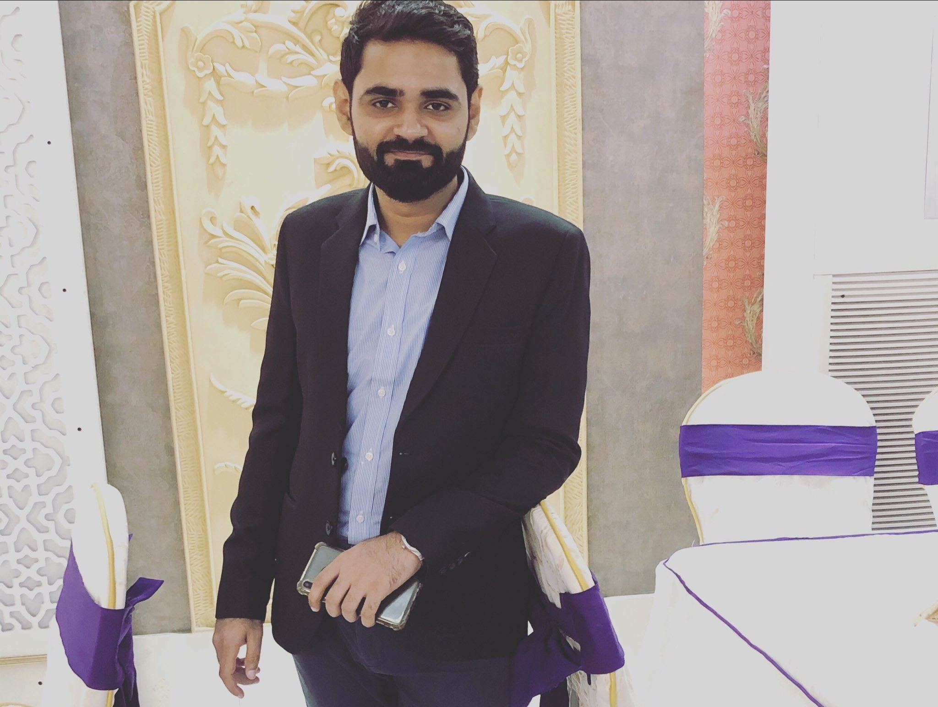
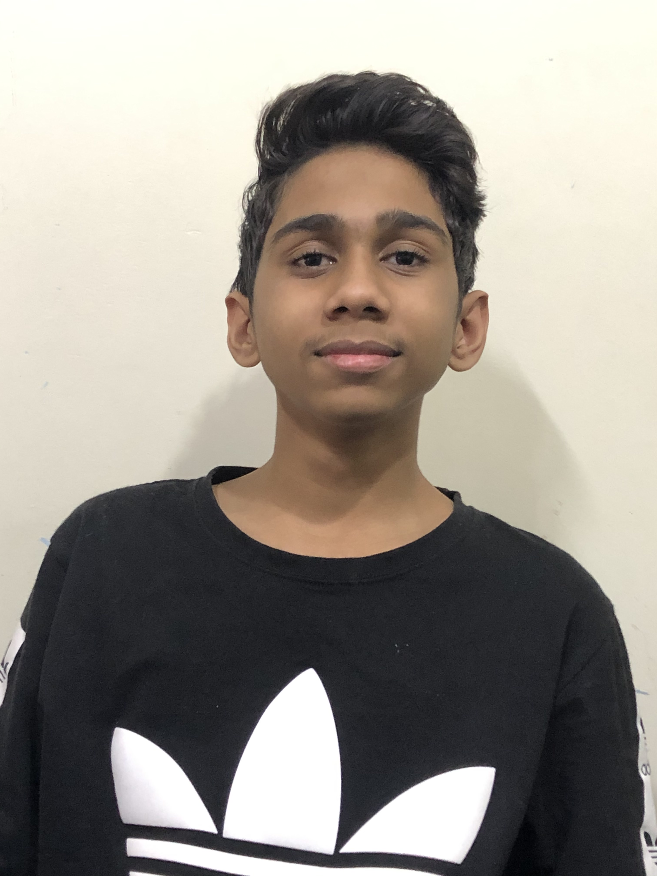
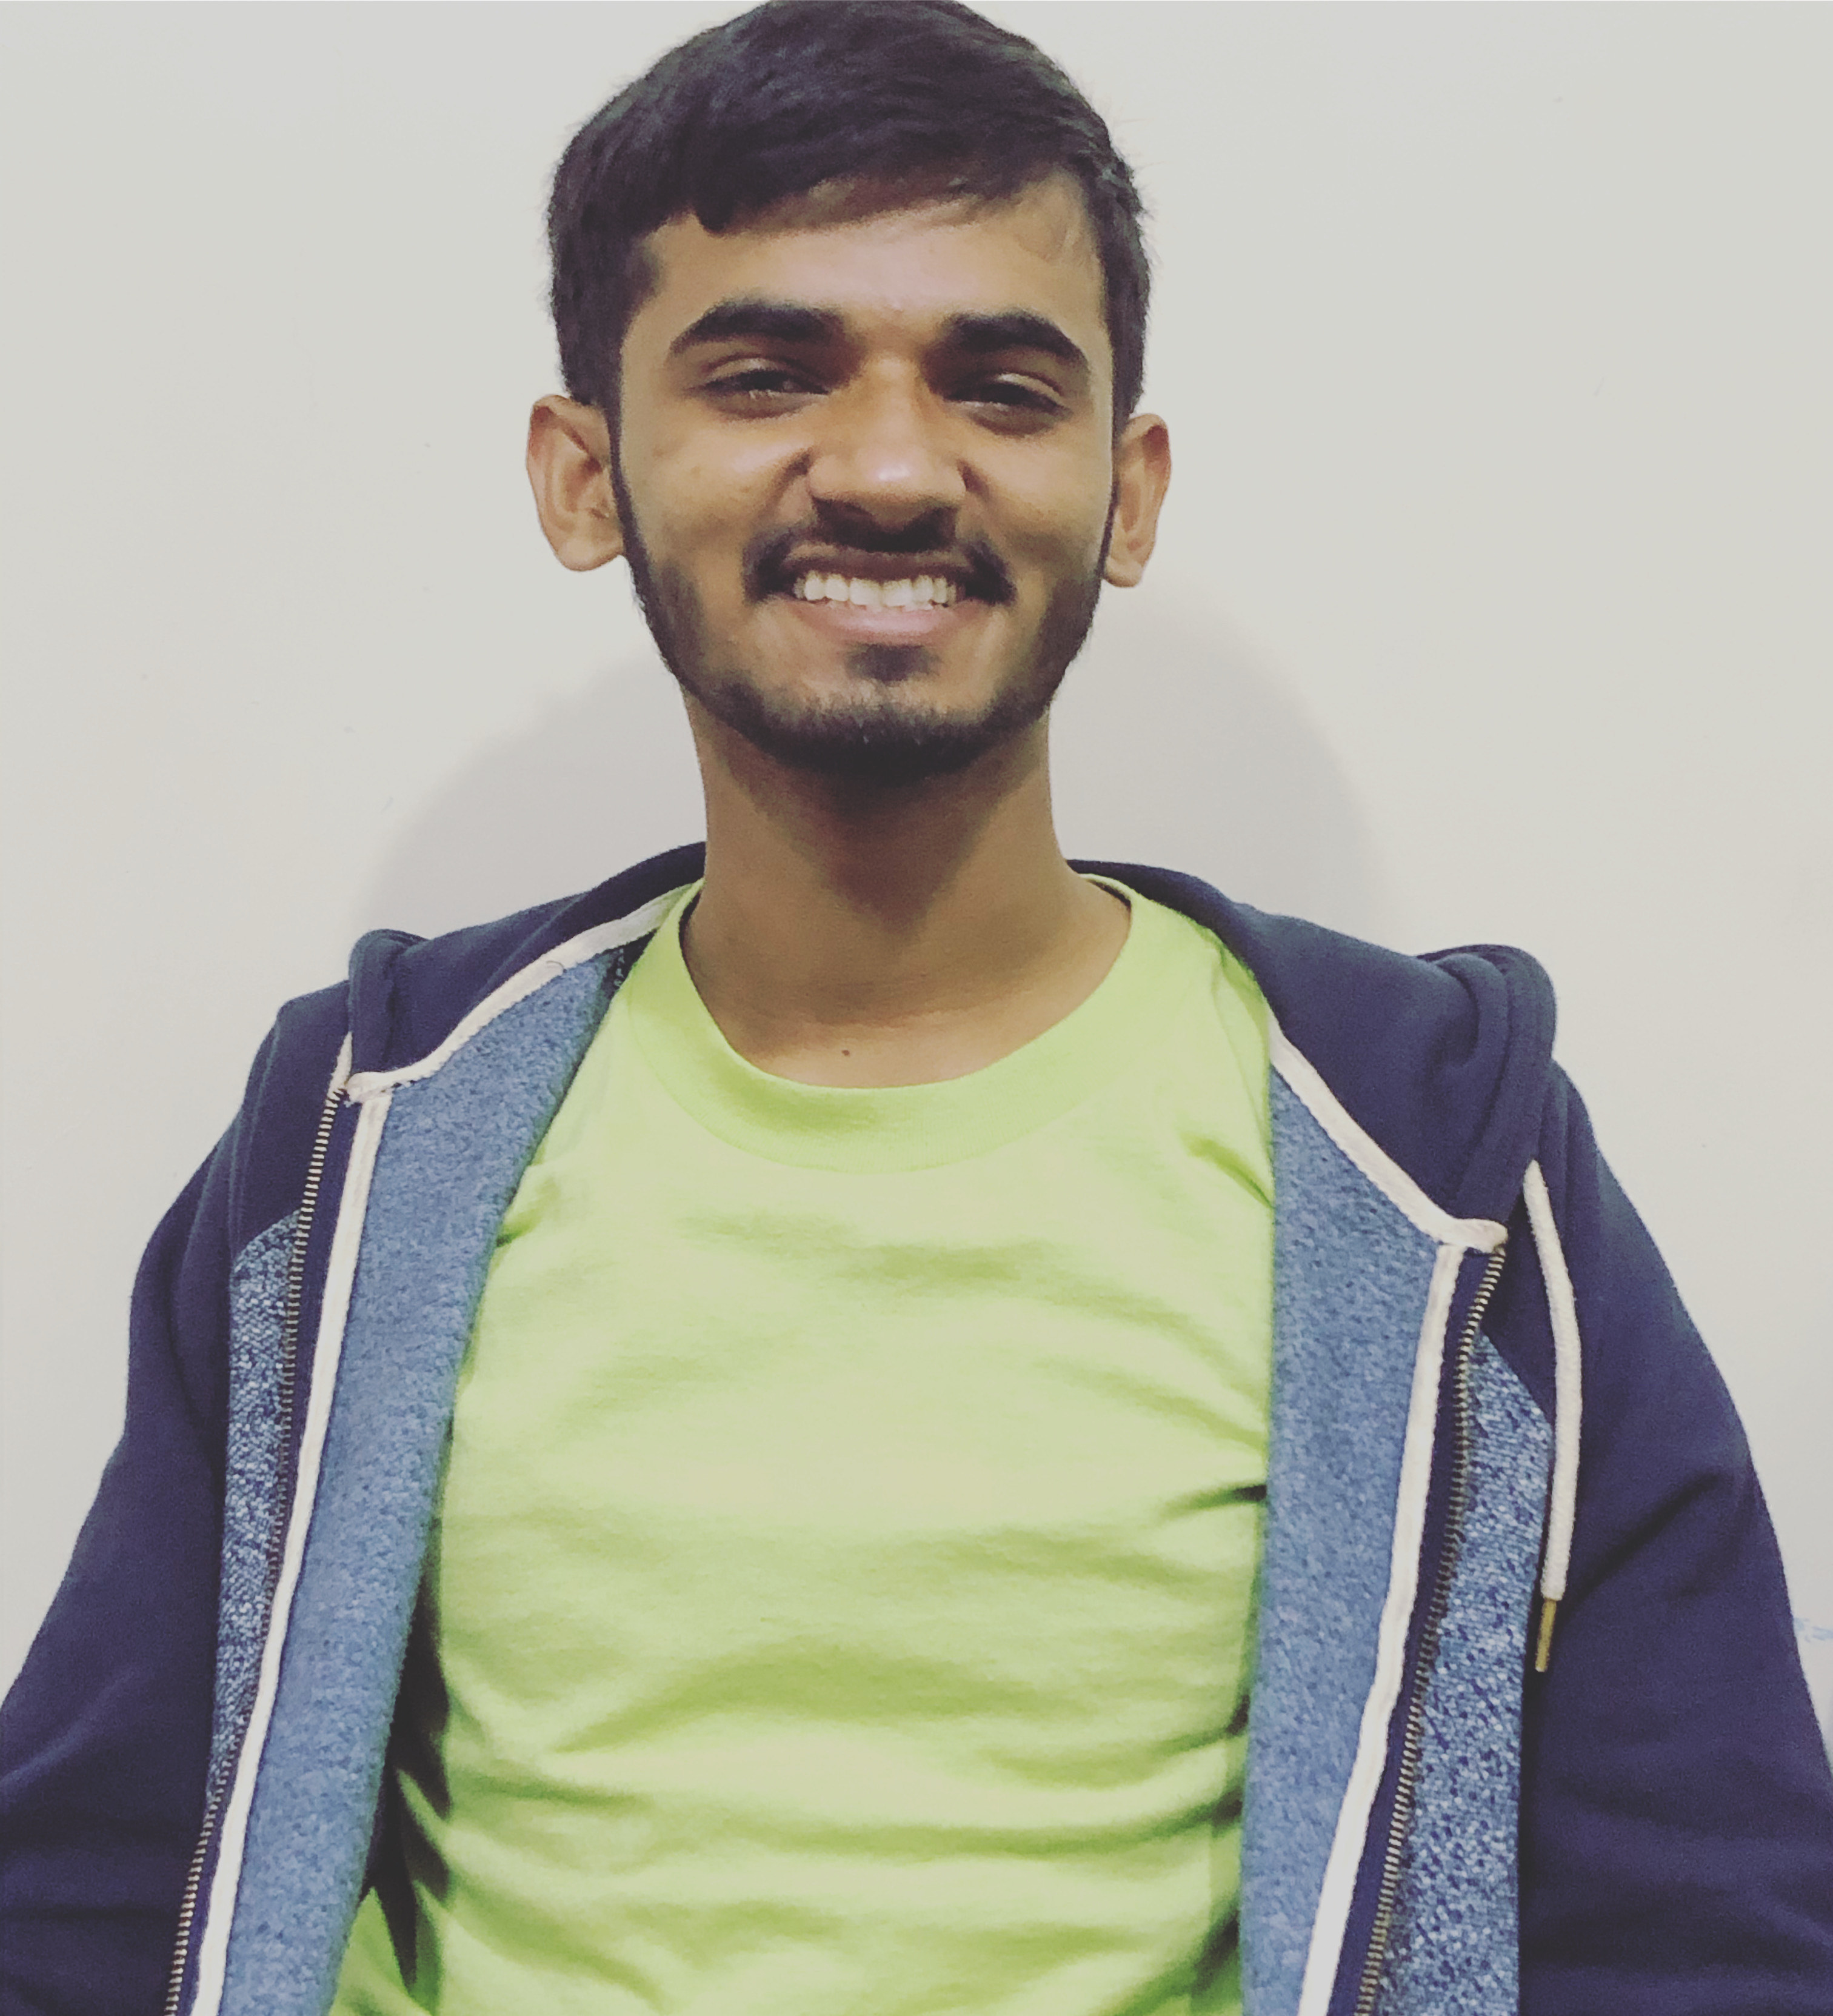
Team Members
Moin Muneer
Moin
Course: CPISM
Sami
Teacher:
Miss Areeba
Asif

Slide 3
CERTIFICATE
This is to certify that this project entitled
“Star Classes” submitted in partial fulfillment of the ACCP EE done by following candidates.
Muhammad Asif
Moin Muneer
Muhammad Sami

Slide 4
Acknowledgement
We are Thankful to ALMIGHTY ALLAH that by HIS Grace we have been successful. We are presenting our Project we have tried our best to take all relevant and necessary topics into our consideration so that this project may become comprehensive.
This is our 1st Semester. We have strived for a better outlook to come. This project has been developed in Visual Studio Code using HTML, CSS & JavaScript. We have been assigned to make a Website namely as our Cpism Project. We tried to observe the coding and its layout in Visual Studio Code. We find it easy to utilize the editor.
We would like to thank Miss Areeba Naseem for his guidance and for giving us time from their busy schedule.
We also express our sincere gratitude to E-Project team from APTECH CLIFTON CENTER, for their valuable guidance and support for the completion of this project.
We earnestly hope that this project will provide all the necessary information required by the user to fulfill his/her inspiration. However, suggestion and feedbacks for improvements will be thankfully welcomed & acknowledged.
Thank You.

Slide 5
REQUIREMENTS
The Web site is to be created based on the following requirements:
The home page is designed with beautiful color combination with all the required links defined properly. Also all the section of the webpage is used to avoid the blank space.
All the features are mentioned on top of the main page.
All courses are shown with their name and detailed section shows in a modal.
Facts, Contact Us are included.
Address, email and phone number included.
Faculty information also added as requirement.
Fee structure can be downloaded.
Navigation of the project is smooth.

Slide 6
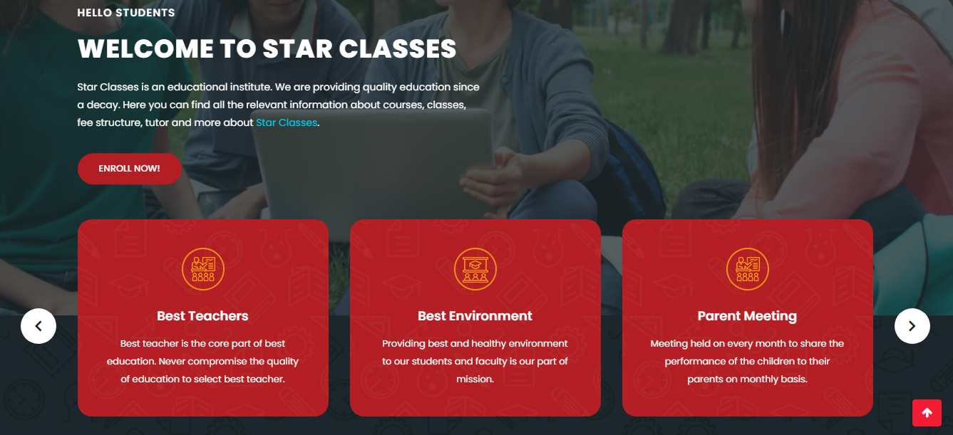
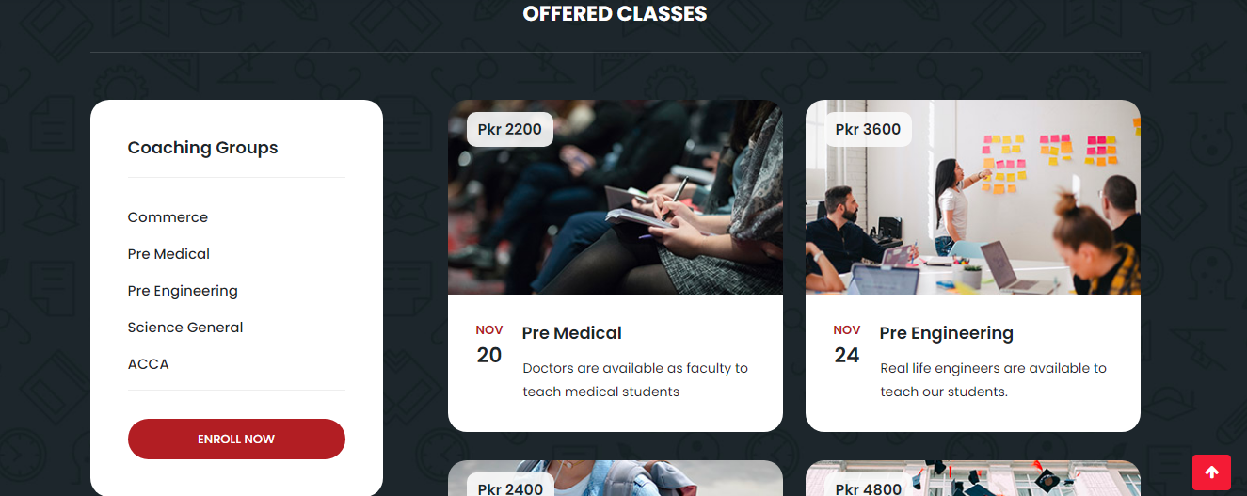
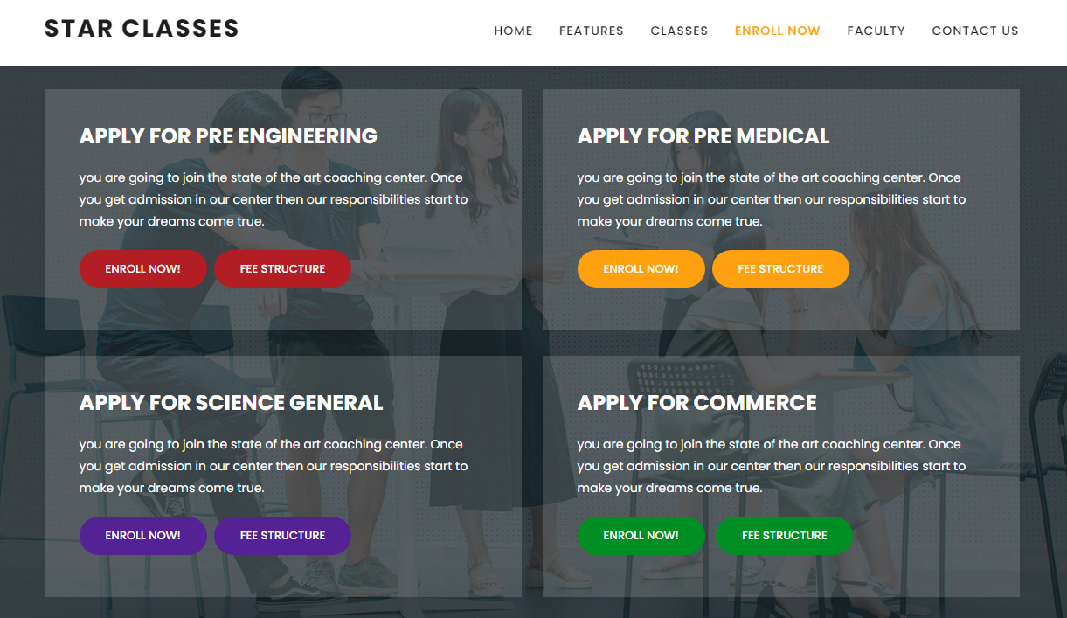
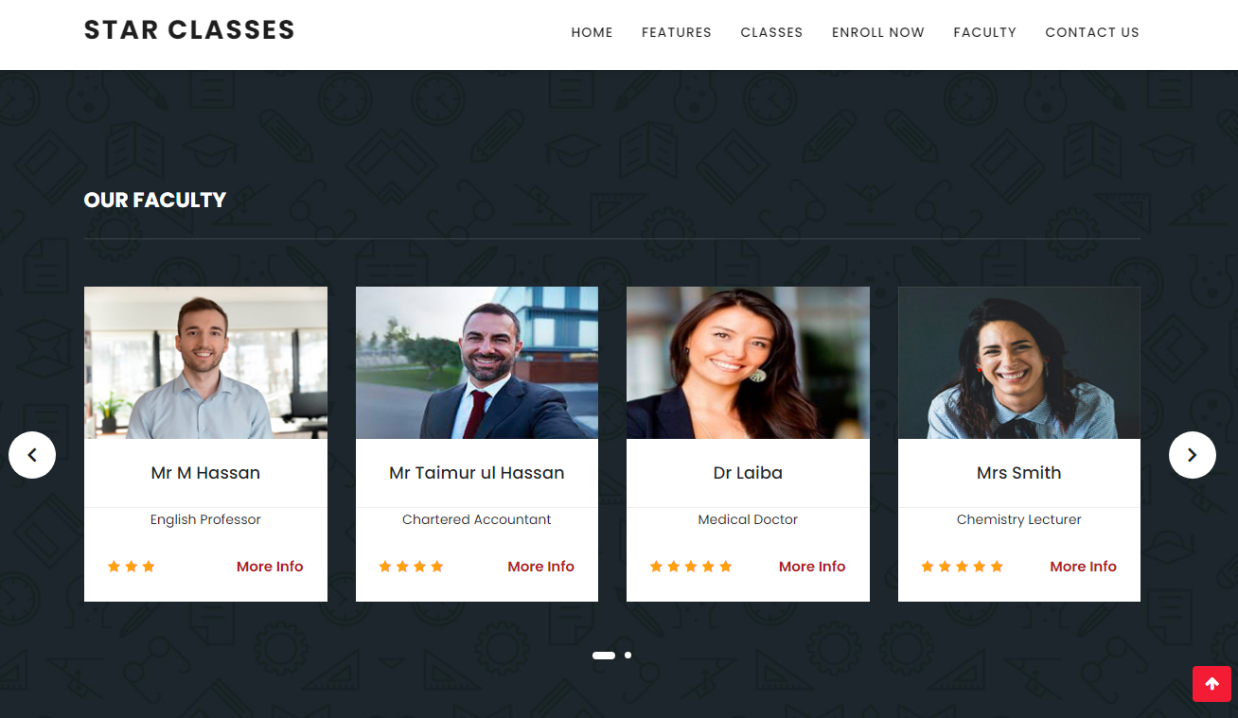
Explore Star Classes coaching center
And know more about our center

Slide 7

Master Head of the site where user
Will find basic info about Star Classes

Slide 8
Courses being offered by Star Classes

Slide 9
User can see more info about course and can download Fee Structure

Slide 10
Faculty detail included in Star Classes

Slide 11
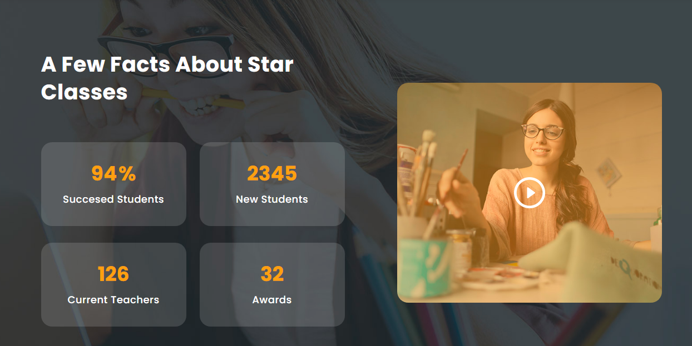
Facts about Star Classes

Slide 12
TASK SHEET
Project Ref. No. |  | Project Title | Date of Preparation of Activity Plan
S.No. | Task | MERCIADO | Actual Days | Team Mate Name | Status
1 | Analysis |  | 25 | Sami, Moin, Asif | OK
2 | Design |  | 25 | Sami, Moin, Asif | OK
3 | Development |  | 25 | Sami, Moin, Asif | OK
4 | Testing |  | 25 | Sami, Moin, Asif | OK
5 | Documentation |  | 5 | Sami, Moin, Asif | OK

Slide 13
Thankyou

